Slide 1

Stage 3 Broken Ankles Course Designer: Xuzi Zhou & Marcel Englmaier
Broken Ankles is a 34 round, 170 point Comstock long course. There are 17 USPSA targets. The best two hits per target will score. The start signal is audible.
The handgun start position is standing with feet touching start stick. Handgun loaded and holstered, wrist below belt. The PCC start position is standing with feet touching start stick. PCC loaded, stock on belt and safety on.
On the audible start signal, engage all targets from within the shooting area.

Slide 2
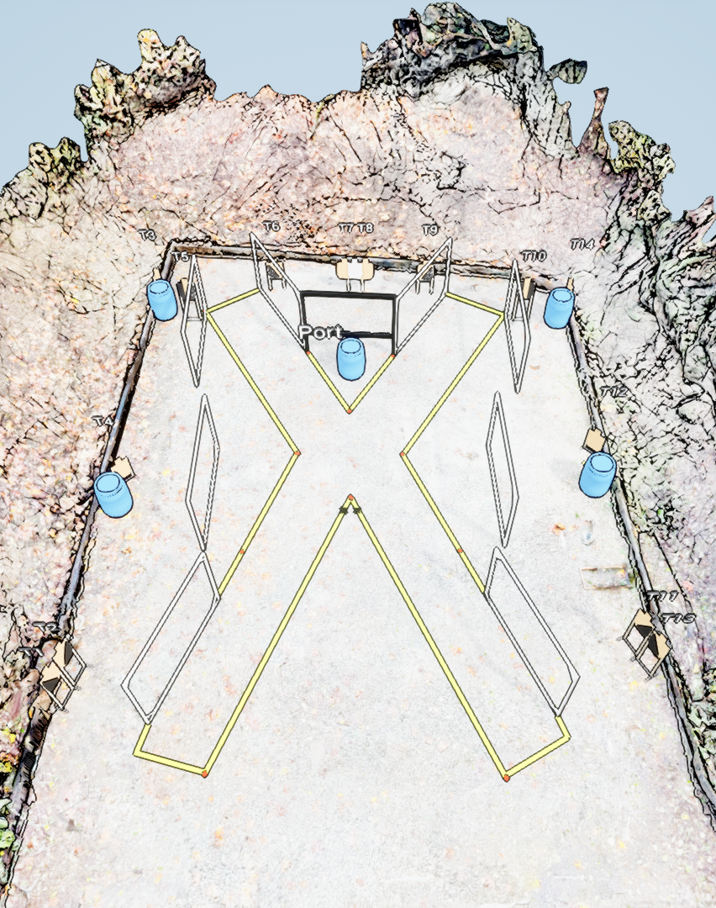
 | Stage 3 Broken Ankles Course Designer: Xuzi Zhou & Marcel Englmaier

